Slide 1
Ｄｉｓｔｒｉｂｕｔｅｄ(Direct ) Interconnection Networks
AMANO, Hideharu
Textbook pp.１４０－１４７

Slide 2
Ｄｉｓｔｒｉｂｕｔｅｄ（Direct Interconnection ）Networks
Nodes are connected with links directly.
Locality of communication can be used.
Extension to large size is easy.

Slide 3
Basic direct networks
Linear
Ring
Central concentration
Tree
Complete connection
Mesh

Slide 4
Metrics of Direct interconnection network（D and ｄ）
Diameter：D
Number of hops between most distant two nodes through the minimal path
degree: d
The largest number of links per a node.
D represents performance and ｄ represents cost
Recent trends:
Performance: Throughput
Cost: The number of long links

Slide 5
Diameter
２（ｎ－１）

Slide 6
Other requirements
Uniformity：Every node/link has the same configuration.
Expandability: The size can be easily extended.
Fault Tolerance: A single fault on link or node does not cause a fatal damage on the total network.
Embeddability: Emulating other networks
Bisection Bandwidth

Slide 7
bi-section bandwidth
The total amount of data
traffic between two halves of
the network.

Slide 8
Hypercube
0000
0001
0010
0011
0100
0101
0110
0111
1000
1001
1010
1011
1100
1101
1110
1111

Slide 9
Routing on hypercube
0101→1100
0000
0001
0010
0011
Different bits
0100
0101
0110
0111
1000
1001
1010
1011
1100
1101
1110
1111

Slide 10
The diameter of hypercube
0101→1010
0000
0001
0010
0011
All bits are different
→ the largest distance
0100
0101
0110
0111
1000
1001
1010
1011
1100
1101
1110
1111

Slide 11
Characteristics of hypercube
D=d=ｌｏｇＮ
High throughput, Bisection Bandwidth
Enbeddability for various networks
Satisfies all fundamental characteristics of direct networks（Expandability is questionable）
Most of the first generation of NORA machines are hypercubes（iPSC，NCUBE，FPS-T）

Slide 12
Problems of hypercube
Large number of links
Large number of distant links
High bandwidth links are difficult for a high performance processors.
Small D does not contribute performance because of innovation of packet transfer.
Programming is difficult: → Hypercube’s dilemma

Slide 13
Is hypercube extendable?
Yes（Theoretical viewpoint）
The throughput increases relational to the system size.
No（Practical viewpoint）
The system size is limited by the link of node.

Slide 14
Hypercube’s dilemma
Programming considering the topology is difficult unlike 2-D,3-D mesh/torus
Programming for random communication network cannot make the use of locality of communication.
2-D/3-D mesh/torus
Killer applications fit to the topology
Partial differential equation, Image processing,…
Simple mapping stratedies
Frequent communicating processes should be
Assigned to neighboring nodes

Slide 15
ｋ-ａｒｙ ｎ-ｃｕｂｅ
Generalized mesh/torus
K-ary n digits number is assigned into each node
For each dimension (digit), links are provided to nodes whose number are the same except the dimension in order.
Rap-around links (ｎ-1→０) form a torus, otherwise mesh.
“high-n” networks are used in recent supercomputers
Tofu in K uses 6-torus
Bluegene Q uses 5-torus

Slide 16
k-ary n-cube
０
０
０
１
０
２
3-ary 1-cube
１
０
１
１
１
２
3-ary 2-cube
２
０
２
２
１
２

Slide 17
k-ary n-cube
２
０
０
２
０
１
２
２
０
１
０
０
１
０
１
１
２
０
０
０
０
０
０
１
０
２
０
１
０
１
２
１
１
２
１
3-ary 1-cube
１
１
１
０
１
１
１
２
０
１
０
０
１
０
１
１
２
１
２
２
２
０
２
２
１
２
3-ary 2-cube
１
１
１
２
０
２
２
１
２
０
２
3-ａｒｙ 3-ｃｕｂｅ
０
０
２
０
２
１
２

Slide 18
３-ary 4-cube
0***
1***
2***

Slide 19
３-ary 5-cube
0****
1****
degree: 2*n
Diameter: (k-1)*n
2****

Slide 20
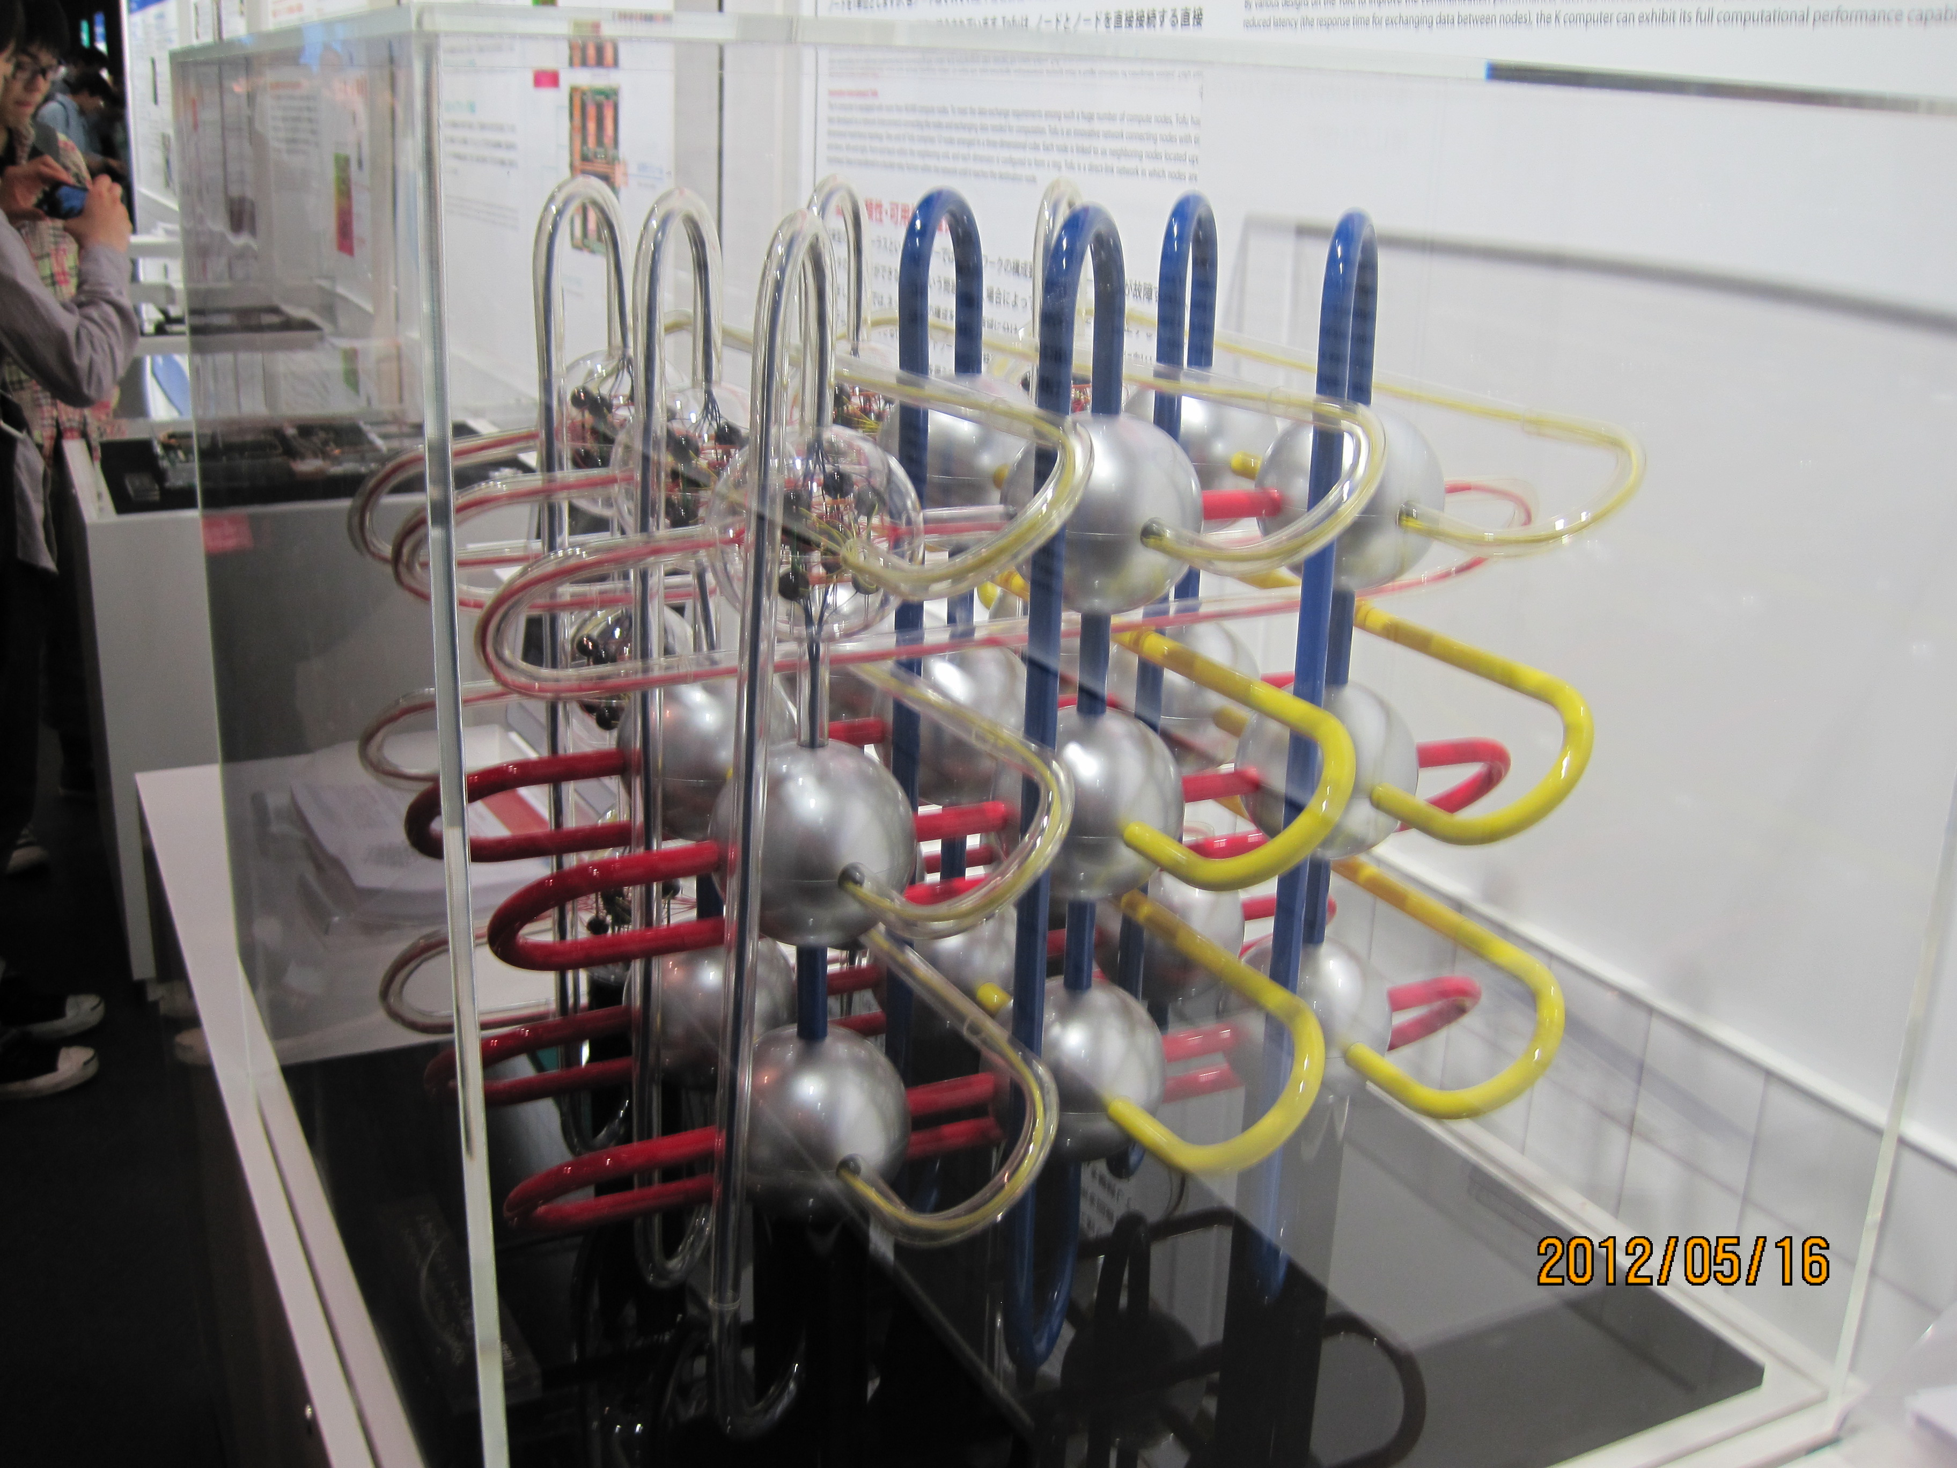
6-dimensional Torus
Tofu

Slide 21
Properties of k-ary n-cube
A class of networks which has Linear, Ring 2-D/3-D mesh/torus and Hypercube（binary n-cube） as its member.
Small d=2n but large D（O(k ))
Large number of neighboring links
k-ary n-cube has been a main stream of NORA networks. Recently, small-n large-k networks are trendy.
1/n

Slide 22
Rise and fall of the members
n
hypercube machines
1980’s
16
HW router
Wormhole, VC
Bandwidth requirement
10
5D/6D Mesh/Torus
2010’s
5
Optical links,
Increasing size
Low-latency requirement
3
2
2D/3D Mesh/Torus 90’s-2000’s
2
100
1000
k

Slide 23
Quiz
Calculate Diameter (D) and degree (d) of the６-ａｒｙ 4-cube (mesh-type).

Slide 24
Glossary 1
Diameter:直径
degree:次数
Uniformity:均一性
Expandability:拡張性
Embeddability:埋め込み能力
Bisection bandwidth:2分割間転送量
Torus:両端が接続されたネットワークで、特にメッシュに対するものを指す。複数形はToriなので注意
ｎ-ary k-cube: n進ｋキューブ 2進キューブのことを特にハイパーキューブと呼ぶ

Slide 25
Advanced direct networks
Shuffle based networks
De Bruijn, Kautz, Pradhan
Extended mesh/torus
Midimew, RDT
Star Graph
Hierarchical networks
CCC, Hypernet
Circular networks
Circular Omega、MDCE
Network inside the chip (Network-on-Chip)
Spidergon, Mesh of Tree, Fat-H Tree
Some of them might be classified into indirect networks

Slide 26
De Bruijn network
001
011
000
010
101
111
100
110
0
1

Slide 27
Routings for De Bruijn
001
011
000
010
101
111
100
110
0
Destination Routing
(001→101)
1

Slide 28
B(k，n)
..
0
..
..
1
K-ary n-digits
..
k-1

Slide 29
Characteristics of De Bruijn
Benefits
d=2k、D=n=logN
When k=2, d=4、D=logＮ，that is, d of 2-dimensional mesh but D of hypercube.
Problems
Optimal routing is difficult (not established yet).
Destination routing cannot make a best use of communication locality.
No killer applications.
Self loop and duplicated links

Slide 30
Kautz network
210
The same number
should not be at the
neighboring digit
121
101
012
212
010
120
201
102
021
202
020

Slide 31
Circular networks
Circular Omega
Advantageous for one-way communication
Used in data-flow machine EM-4
MDCE(CCCB)
Hierarchical structure of Circular Omega（Banyan）
Used in massively parallel machine RWC-1

Slide 32
Circular Omega network
000
000
001
001
010
010
011
011
100
100
101
101
110
110
111
111

Slide 33
Cube Connected Circular Banyan
Circular Banyan
3-Dimensional
Proposed for RWC-1

Slide 34
Star graph
ABCD
DBCA
CBAD
CBDA
BACD
BDCA
BACD
CABD
CDBA
BCDA
ACBD
DCBA
CDAB
BDAC
DCAB
ADCB
DBAC
ADBC
ACDB
DACB
ABDC
DABC
CADB
BADC
Connection n! nodes

Slide 35
Routing on Star graph
ABCD
DBCA
CBAD
CBDA
BACD
BDCA
BACD
CABD
CDBA
BCDA
ACBD
DCBA
CDAB
BDAC
DCAB
ADCB
DBAC
ADBC
ACDB
DACB
ABDC
DABC
CADB
BADC
If Ａ is top, change with arbitrary symbol,
else, change with the symbol of destination
node
ＡＢＣＤ → ＤＡＢＣ
３（ｎ－１）／２

Slide 36
Hierarchical network
CCC(Cube Connected Cycles)
ｈｙｐｅｒｃｕｂｅ＋loop
Hypernet
Compete connection＋hypercube
Well combined, weak points of original networks are vanished.
Complicated routing, gap between hierarchies

Slide 37
CCC(Cube Connected Cycles)
000
001
100
101
0
1
2
010
011
110
111

Slide 38
Hyper Net
h
b
i
d
o
c
a
b
j
c
e
d
f
k
h
m
e
f
g
l
a
n
g
p
Other links are used for
further upper hierarchy

Slide 39
Extended mesh/torus
Including mesh/torus structure
Extended links for performance enhancement
Reconfigurable Mesh
Midimew
RDT

Slide 40
RDT(Recursive Diagonal Torus)

Slide 41
Multicasting on the RDT

Slide 42
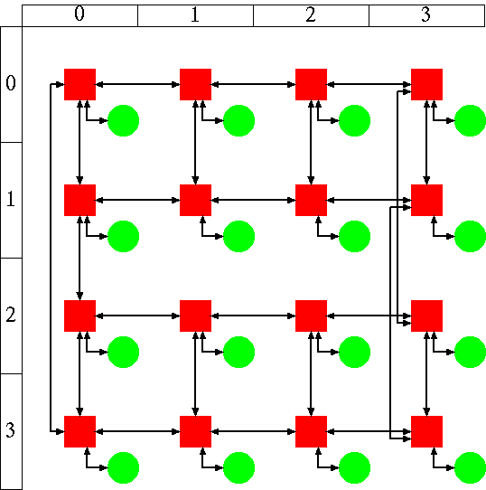
Topology for NoC: (1)
Spidergon
Ring + diagonal links
Node degree 3;
[Coppola, ISSOC’04]
[Bononi, DATE’06]
Spidergon (2-D layout)
router
core

Slide 43
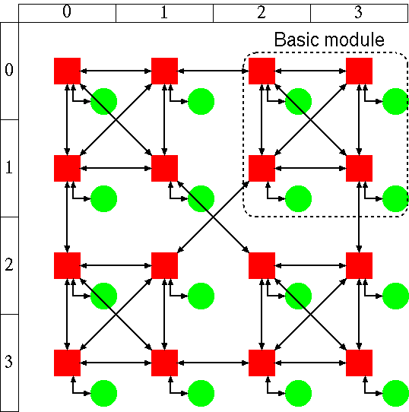
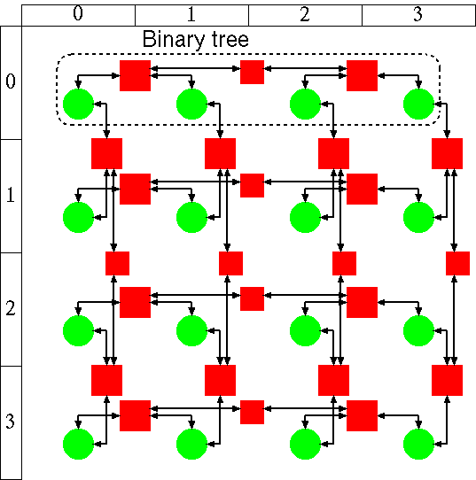
Topology for NoC: (2)
WK-recursive (d,k)
hierarchical network
Mesh-of-Tree
Mesh + Tree
WK-recursive (4,2)
Mesh-of-Tree
[Vecchia, FCGS’88]
router
計算コア
[Leighton, Math System theory’84]
[Rahmati, ICCD’06]

Slide 44
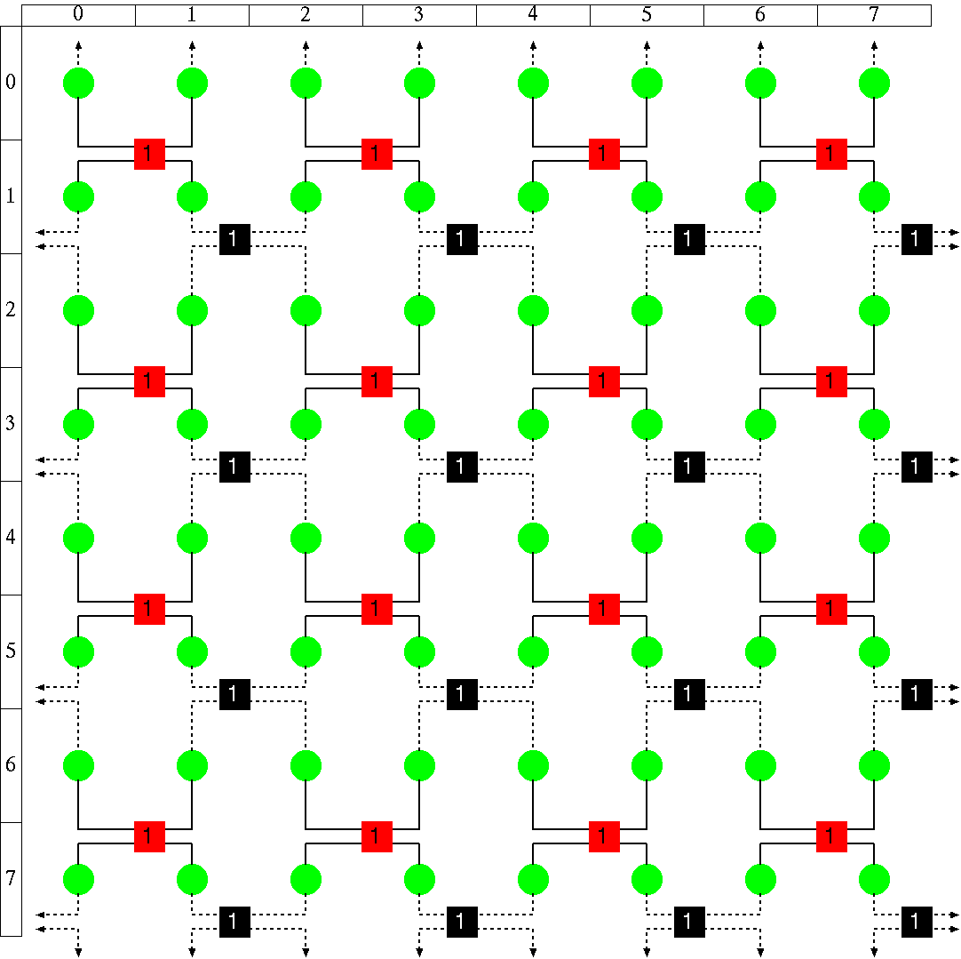
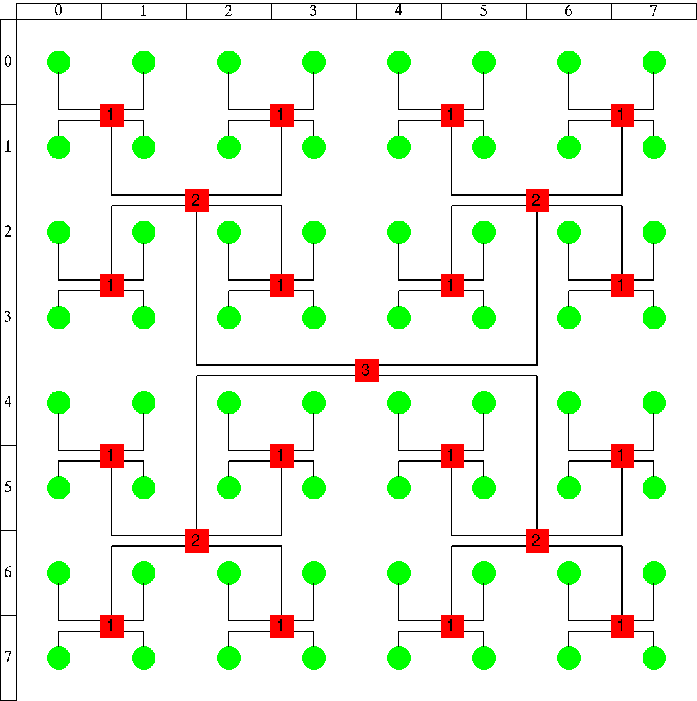
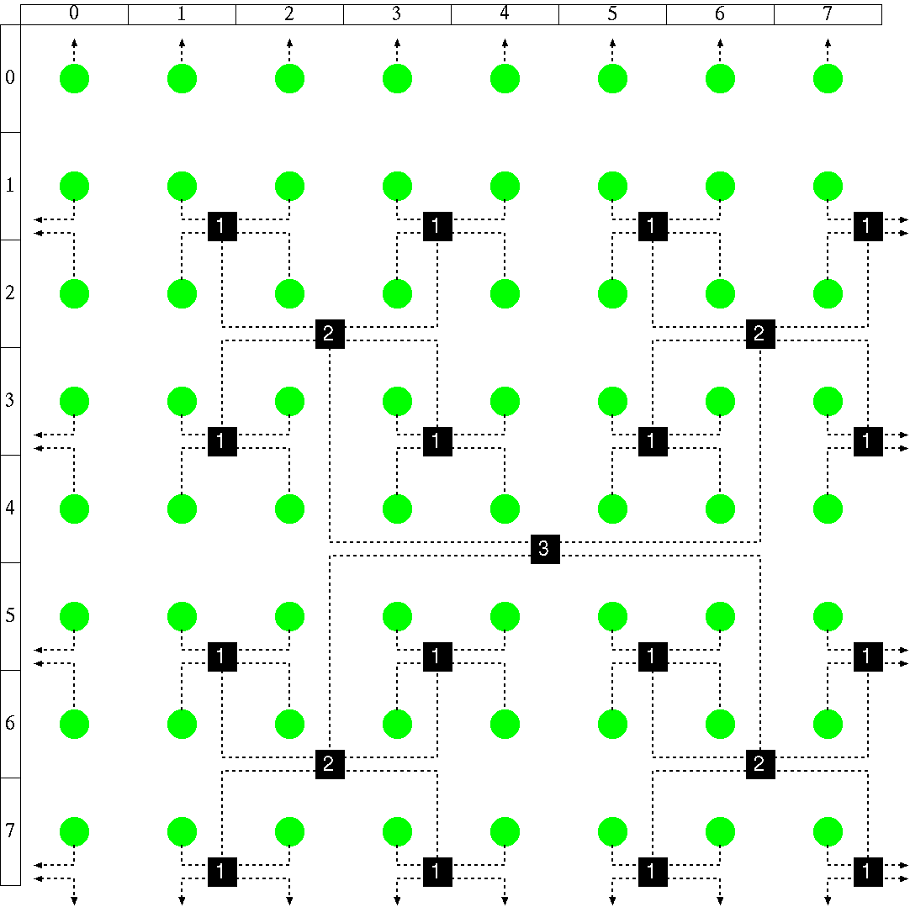
Fat H-Tree： A network topology for NoCs
Torus is formed
Each core connects to Red tree and Black tree
(※) routers for more than rank-2 are omitted
router, Core
router, Core

Slide 45
Glossary 2
De Bruijin:人の名前でドブロイアンと読むのが本来の読み方だが英語圏の人はこれをデブルージンと読むので注意（最初全然わかんなかった）

Slide 46
Summary
Recently, practical new topologies are not proposed.
A lot of “made-in-Japan” networks
Asymmetric indirect networks will be widely used.

Slide 47
Exercise
Compute diameter of CCC with 16 cycles each of which has 4 nodes.
Hint: How is the method to move between cycles efficiently?

